Slide 1
Twitter Networks
Meshal Almuraheb, Tony Blonigan, Darius Nyaundi, Jideofor Onyeneho, Sander Quint

Slide 2
Agenda:
- Data Description
- Data Pre-processing
- Inbound/Outbound Classification
- Author ID Classification for Corporate Accounts
- Sentiment Analysis
- Q&A

Slide 3
Data Description
Data
The data contains tweets that were sent from and to customer support twitter accounts of several companies (Amazon, Apple, etc.).
Number of Records
Our data contains 2,811,774 records.
Number of Attributes
Our data has 7 attributes.

Slide 4
Data Description
tweet_id | Numerical | A unique, anonymized ID for the Tweet. Referenced by response_tweet_id and in_response_to_tweet_id.
author_id | Numerical | A unique, anonymized user ID. @s in the dataset have been replaced with their associated anonymized user ID.
inbound | Categorical | Whether the tweet is "inbound" to a company doing customer support on Twitter.
created_at | Timestamp | Date and time when the tweet was sent.
text | String | Tweet content. Sensitive information like phone numbers and email addresses are replaced with mask values like __email__.
response_tweet_id | Numerical | IDs of tweets that are responses to this tweet, comma-separated.
in_response_to_tweet_id | Numerical | ID of the tweet this tweet is in response to, if any.

Slide 5

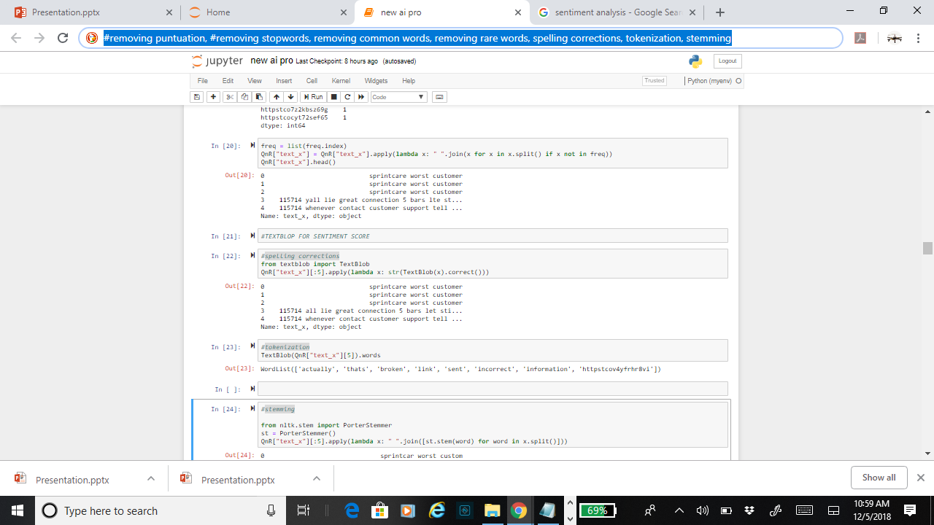
Data Pre-processing
Items removed in our models include:
- All non-alphabetical characters
- Short words
- Long words
- Stop words (one model did not use it)
- URL protocol leaders (e.g. https://)
- Username tags

Slide 6
Data Pre-processing
All text needed to be:
- Corrected for spelling
- Lowercased
- Tokenized
- Stemmed
- Lemmatized
For sequential text input

Slide 7
Problem Framing
Classifying whether a tweet is inbound or outbound
Tweet Text
Inbound tweets (tweets addressed to a company account)
Outbound tweets (tweets addressed to customer)
Data Pre-Processing
Empty Documents Removal
Challenges
Resource Limitation

Slide 8

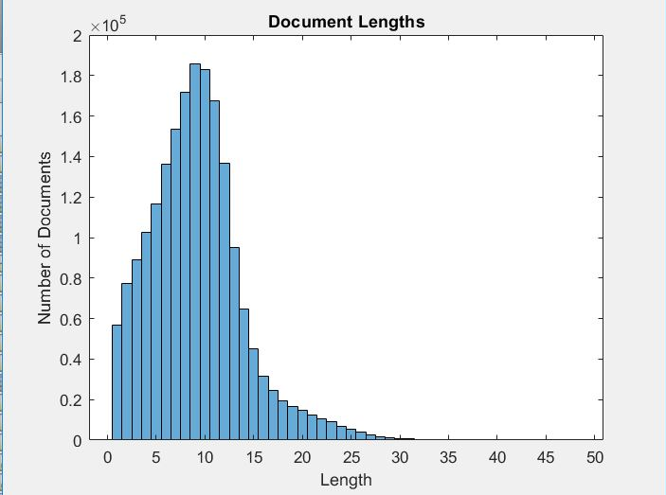
Model Description
LSTM Network (Many to One)
Sequence Length = 13
Sequence Input Layer
Word Embedding Layer
LSTM Layer
Fully Connected Layer
Soft Max Layer
Classification Layer
Notes:
A word embedding layer maps word indices to vectors.
embeddingDimension = 100;
numHiddenUnits = enc.NumWords;
hiddenSize = 180;

Slide 9
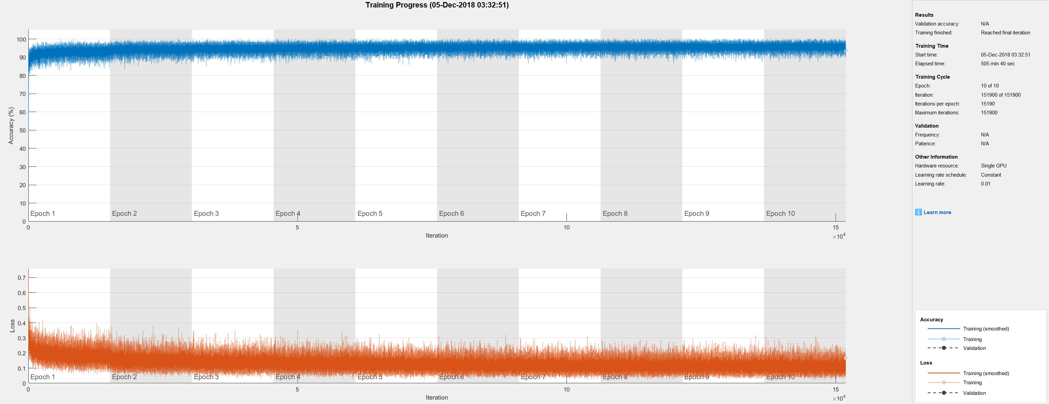
Model Performance (Training Progress)

Slide 10
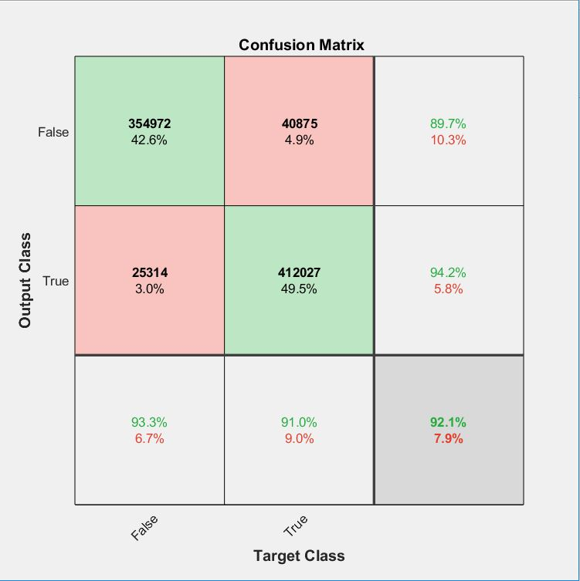
Model Performance
Model Accuracy = 92%
F1 Score (False) = 0.7934
F1 Score (True) = 0.7657

Slide 11
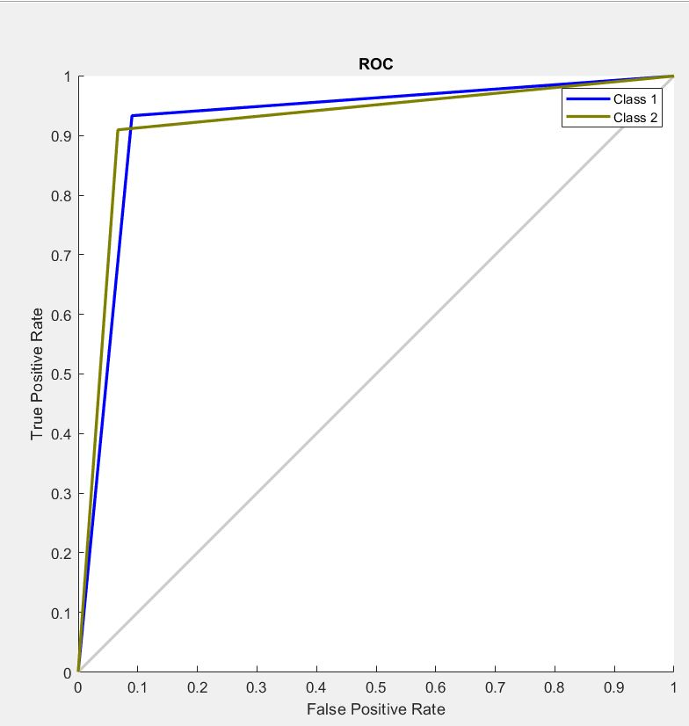
Model Performance (ROC Curve)
Class 1 : False
Class 2 : True

Slide 12
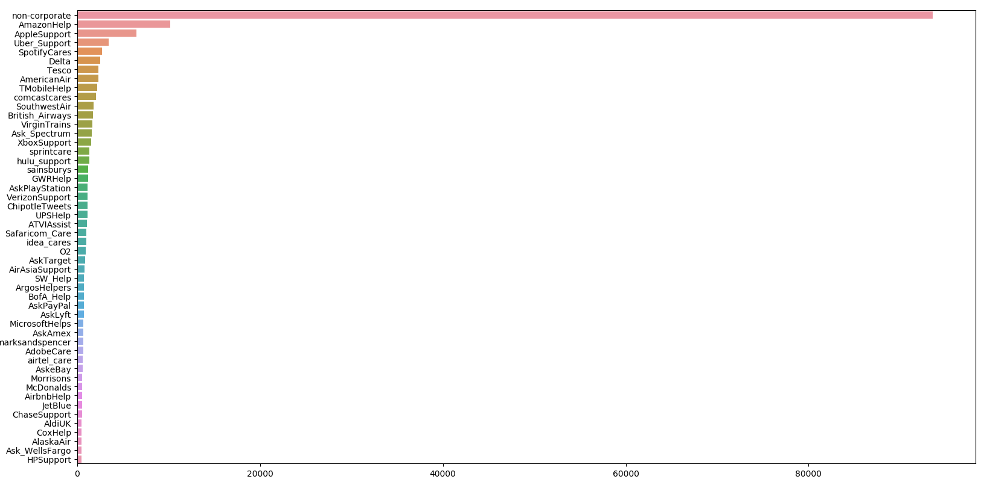
Problem Framing: Author Classification
Classify tweets by author using tweet text
45 classes
All tweets written by non-corporate accounts are labeled 'non_corporate'
Preprocessing
remove punctuation > remove @user tags > simplify 'http://' > lower case > fix double spacing > porter stemmer > tokenize > post padding > word embedding
Challenges: Unbalanced class representation

Slide 13
GRU & LSTM – Architecture (LSTM was same but with an LSTM instead of GRU layer)
_________________________________________________________________
Layer (type) Output Shape Param # ================================================================= embedding_1_input (InputLaye (None, 68) 0 _________________________________________________________________ embedding_1 (Embedding) (None, 68, 500) 31679000 _________________________________________________________________ gru_1 (GRU) (None, 200) 420600 _________________________________________________________________ dropout_10 (Dropout) (None, 200) 0 _________________________________________________________________ dense_14 (Dense) (None, 100) 20100 _________________________________________________________________ dropout_11 (Dropout) (None, 100) 0 _________________________________________________________________ dense_15 (Dense) (None, 50) 5050 _________________________________________________________________ dense_16 (Dense) (None, 45) 2295 ================================================================= Total params: 32,127,045 Trainable params: 448,045 Non-trainable params: 31,679,000

Slide 14
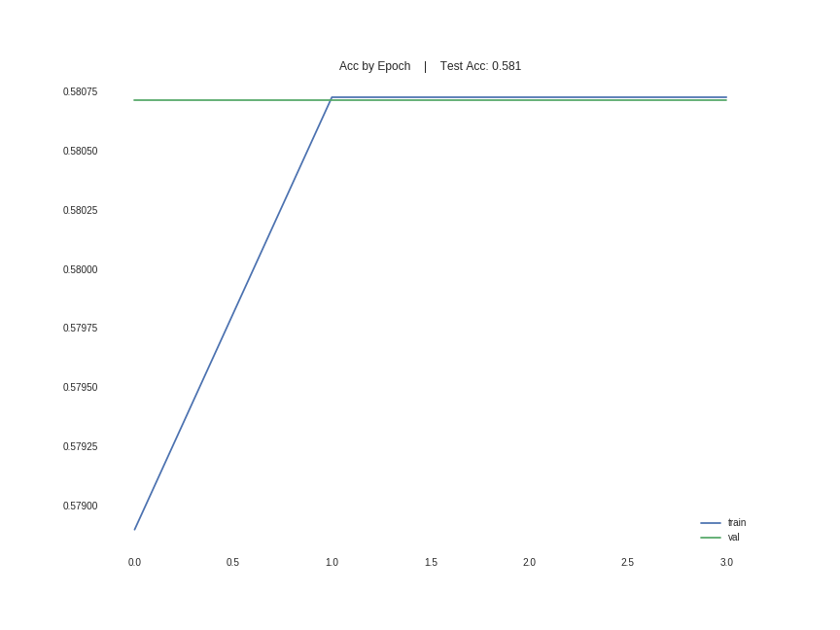
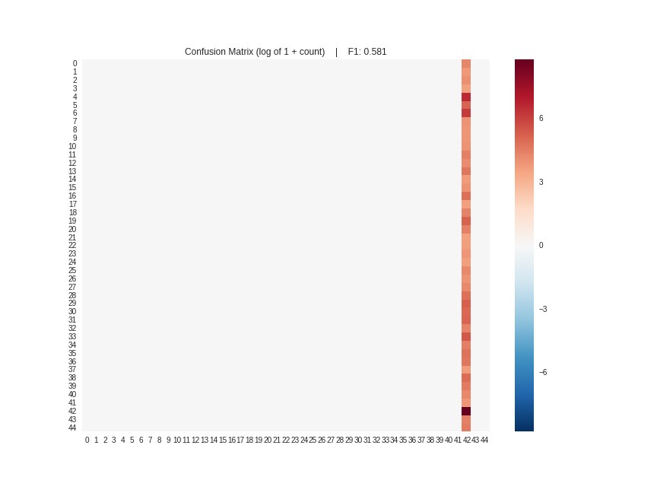
GRU & LSTM - Performance

Slide 15
Word Embedding - Architecture
_________________________________________________________________
Layer (type) Output Shape Param #
=================================================================
embedding_1 (Embedding) (None, 68, 500) 31679000
_________________________________________________________________
flatten_1 (Flatten) (None, 34000) 0
_________________________________________________________________
dense_1 (Dense) (None, 45) 1530045
=================================================================
Total params: 33,209,045
Trainable params: 33,209,045
Non-trainable params: 0
_________________________________________________________________

Slide 16
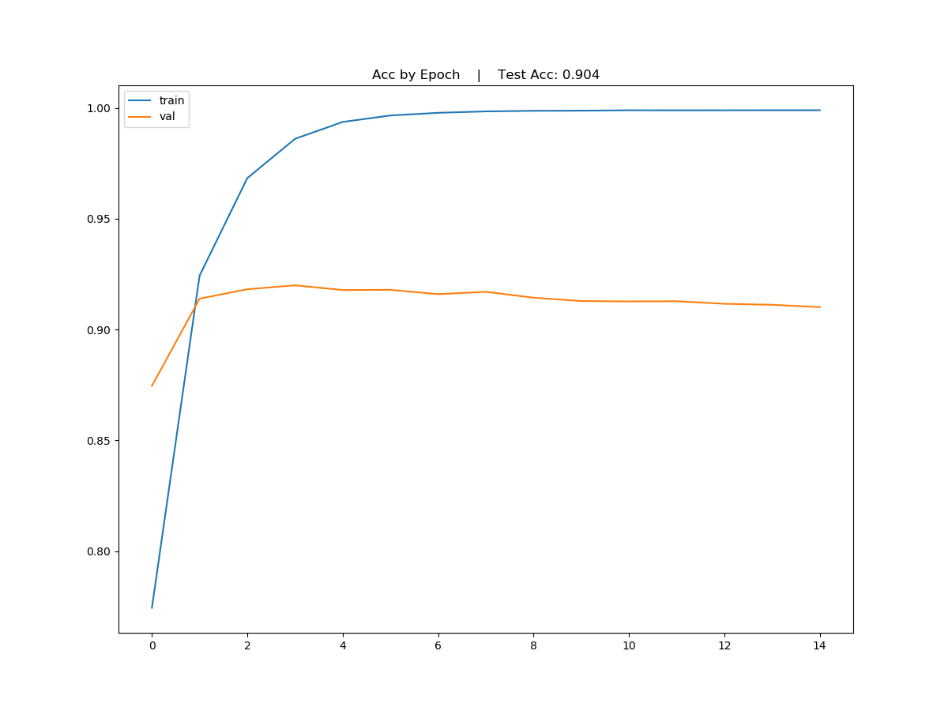
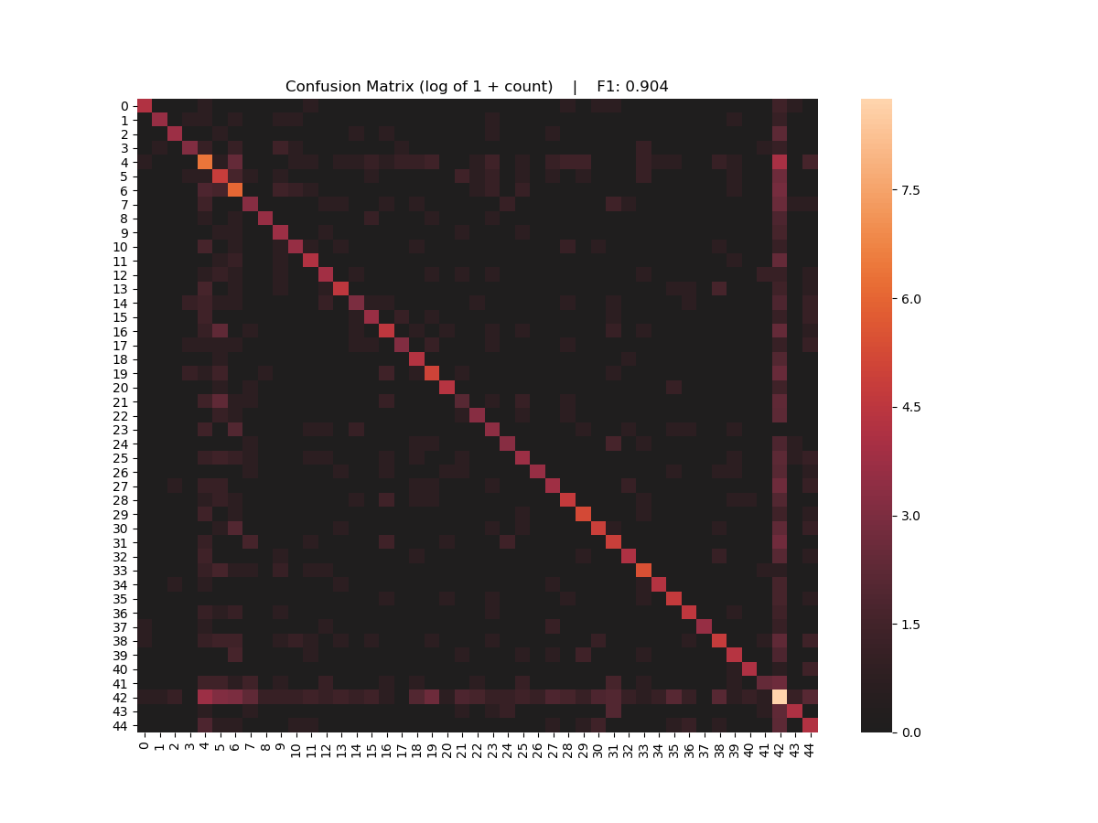
Word Embedding - Performance
NOTE: Transfer learning feeding this word embedding to an RNN produced the same results shown in the previous slide (everything classified as majority class)

Slide 17
Fully Connected - Architecture
_________________________________________________________________
Layer (type) Output Shape Param #
=================================================================
embedding_1 (Embedding) (None, 106, 500) 74617500
_________________________________________________________________
flatten_1 (Flatten) (None, 53000) 0
_________________________________________________________________
dense_1 (Dense) (None, 200) 10600200
_________________________________________________________________
dropout_1 (Dropout) (None, 200) 0
_________________________________________________________________
dense_2 (Dense) (None, 100) 20100
_________________________________________________________________
dropout_2 (Dropout) (None, 100) 0
_________________________________________________________________
dense_3 (Dense) (None, 50) 5050
_________________________________________________________________
dense_4 (Dense) (None, 45) 2295
=================================================================
Total params: 85,245,145
Trainable params: 85,245,145
Non-trainable params: 0

Slide 18
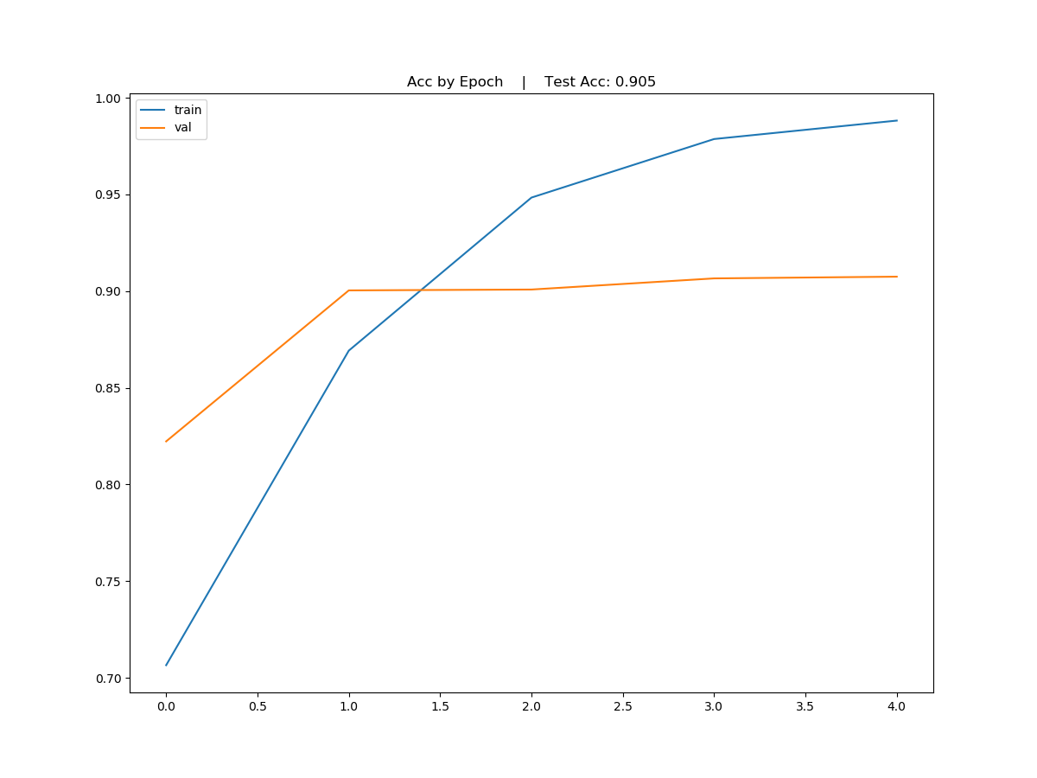
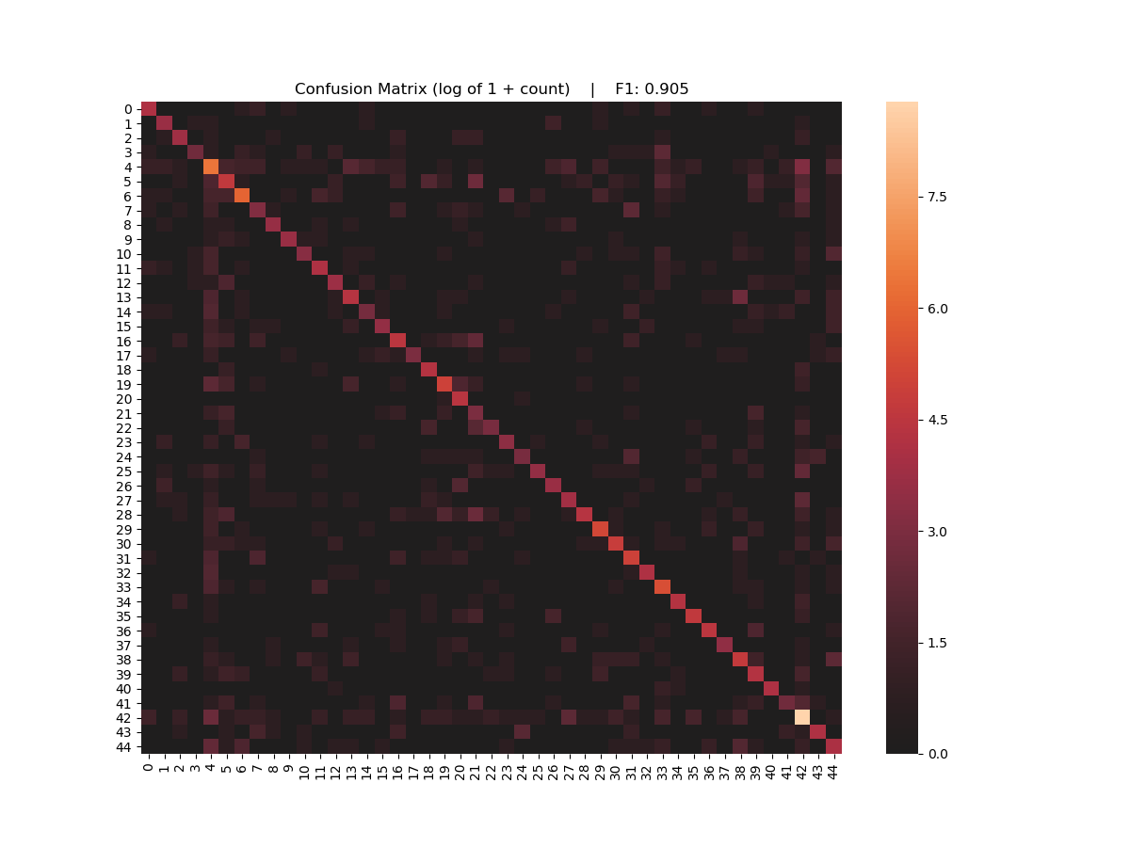
Fully Connected - Performance

Slide 19
Sentiment Analysis

Slide 20
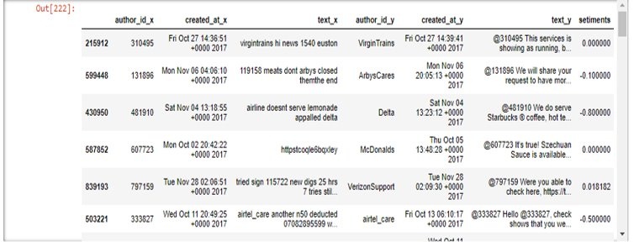
Textblob

Slide 21
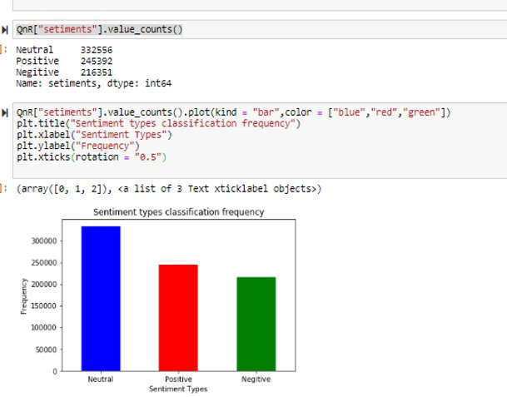
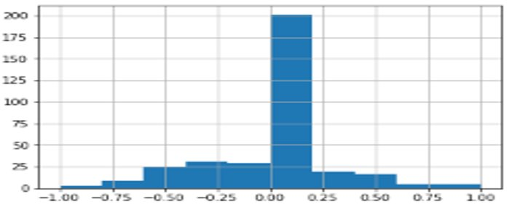
0-.20 / Neutral after cleaning

Slide 22
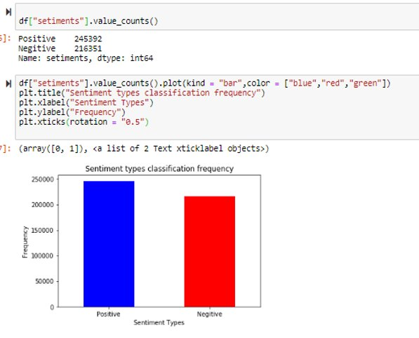
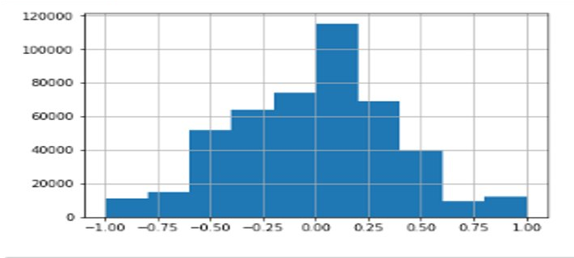
0 values taken out

Slide 23
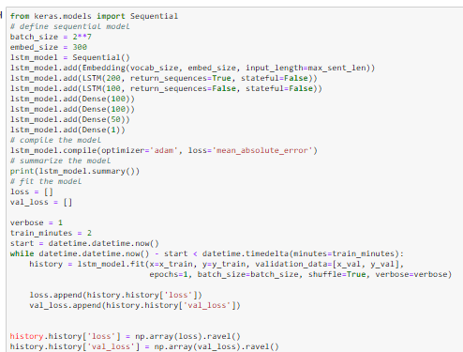
LSTM

Slide 24
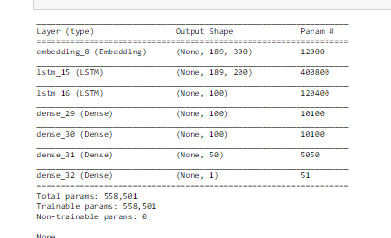

Slide 25
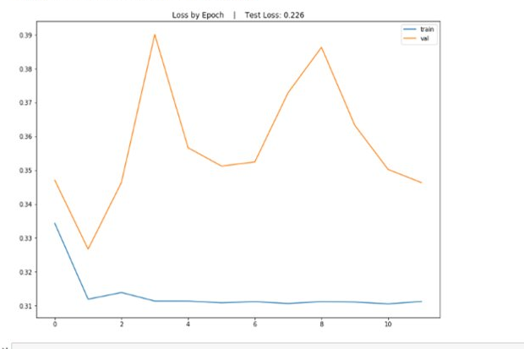
Loss

